Slide 1
LabVIEW Lecture-3
NXT Mindstorms Kit Programming
MEH108 - Intro. To Engineering Applications
KOU Electronics and Communications Engineering

Slide 2
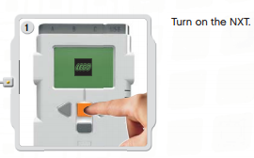
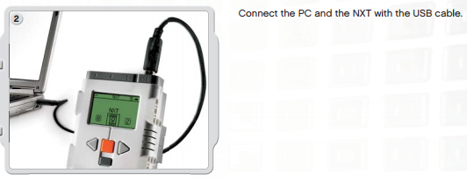
Connecting the NXT kit
Requirements:
LabVIEW 2013,
NXT Toolkit for LabVIEW 2013,
USB cable,
NXT Mindstorms Kit

Slide 3
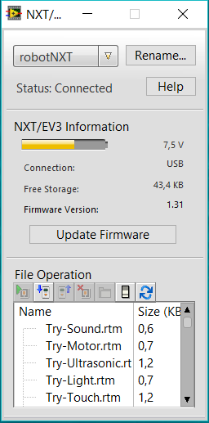
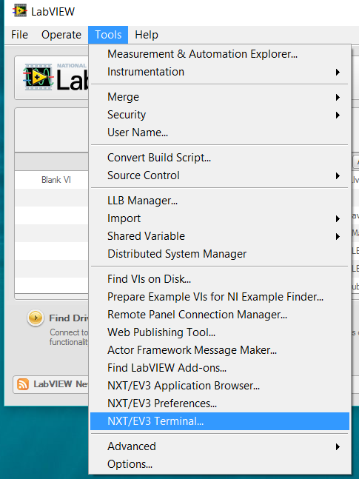
Connecting the NXT kit

Slide 4
Direct Mode ? or Remote Mode?
In Direct Mode:
You must run the program from the computer to the NXT kit using USB or Bluetooth so communication is required while running.
Advantage: You can receive information from NXT or send information to NXT.
In Remote Mode,
You can run the program directly from NXT kit without any communication from the computer.
Advantage: Use NXT kit as a robot.

Slide 5
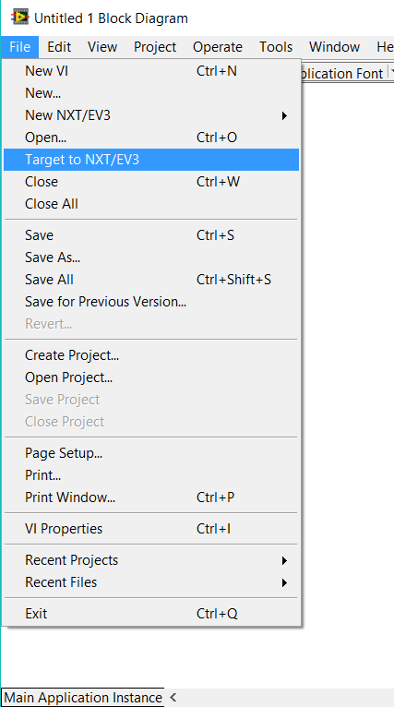
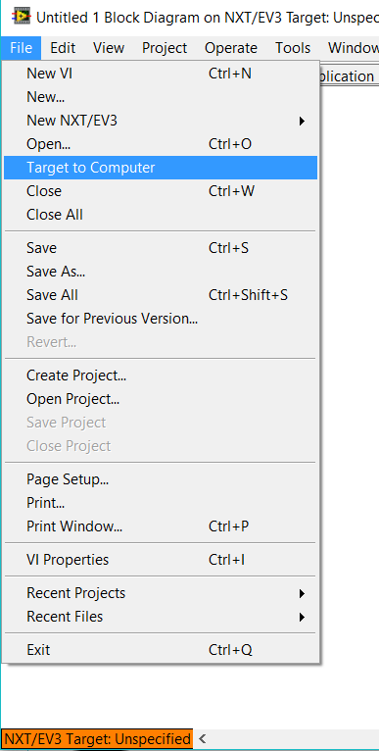
Direct Mode Remote Mode
Change to Remote Mode
Change to Direct Mode

Slide 6
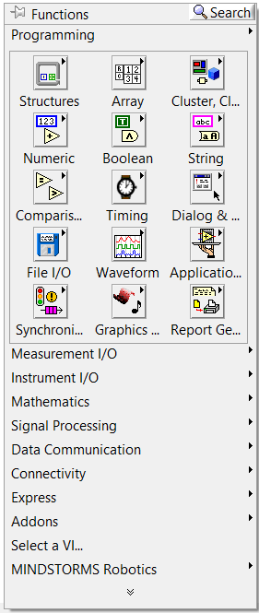
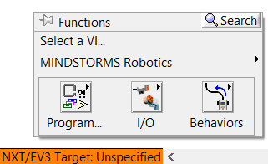
Direct Mode Remote Mode
In remote mode:
* Only NXT functions can be used !

Slide 7
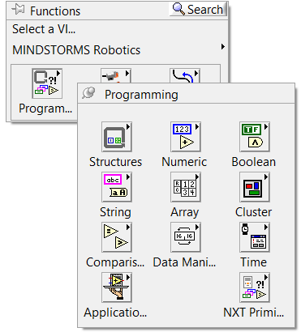
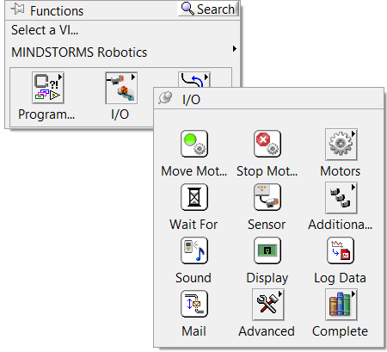
NXT Functions
NXT Programming: Basic programming used in all programming
NXT I/O: Sensors, motors, sound, display, data logging
Behaviour: Pre-made code for controlling robot

Slide 8
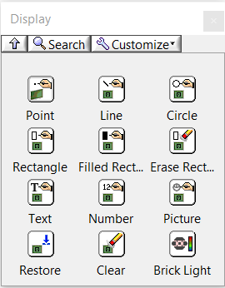
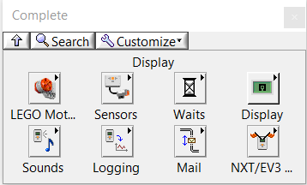
Example 1: Hello World (Display)
* To add a new program «File >> New NXT >> Targeted VI»
* NXT I/O >> Complete >> Select «Display»
* To get more information: Right click >> View as icon
Change to Remote Mode / Direct Mode

Slide 9
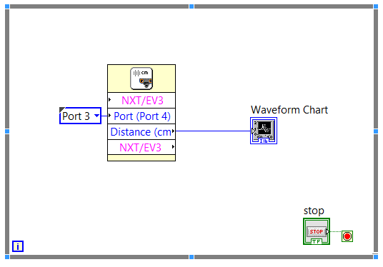
Example 2: Collect and Display Sensor Data
Read Ultrasonic Sensor and plot the measured value on PC.
Connect and configure the sensor port ! Port 1? 2 ? 3 ? 4 ?
* Read sensor continuosly,
* Plot the measured value,
Use Direct Mode !

Slide 10
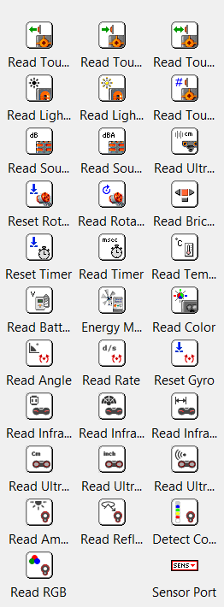
Example 2: Collect and Display Sensor Data
Sensor functions: (I/O >> Complete >> Sensors)
Read Touch (Release, Bumped, Pressed, Count),
Read Light (LED on, LED off),
Read Sound (dB, dBA),
Read Ultrasonic (cm, inch, Listen),
Read/Reset Rotation Angle,
Read NXT Brick Button,
Read/Reset Timer

Slide 11
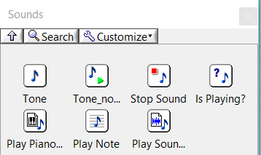
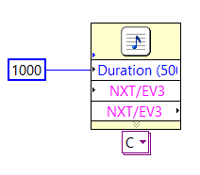
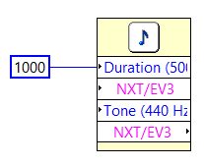
Example 3: Using Loud Speaker
Sensor functions: (I/O >> Complete >> Sounds)
Tone,
Tone no wait,
Stop sound,
Is playing ?
Play note (A,B,C,D,E,F,G),
Play sound file

Slide 12
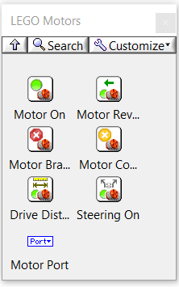
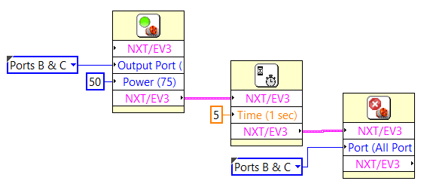
Example 4: Move robot for 5 seconds
Sensor functions: (I/O >> Complete >> LEGO Motors)
Motor on,
Motor reverse,
Motor brake (Stop suddenly),
Motor coast,
Steering on (?)
Move robot for 5 seconds
Connect and configure output ports ! Port A ? B ? C ?

Slide 13
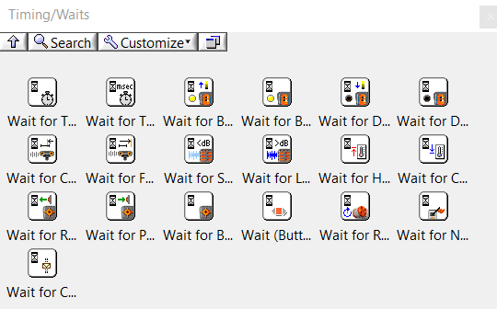
Using Timing/Waits Functions
Sensor functions: (I/O >> Complete >> Waits)
Wait for Time (miliseconds, seconds)
Wait for Darkness/Brightness/Brightness Change,
Wait for Closer/Further,
Wait for Pressed ( Wait until button is pressed)
Wait (Button)

Slide 14
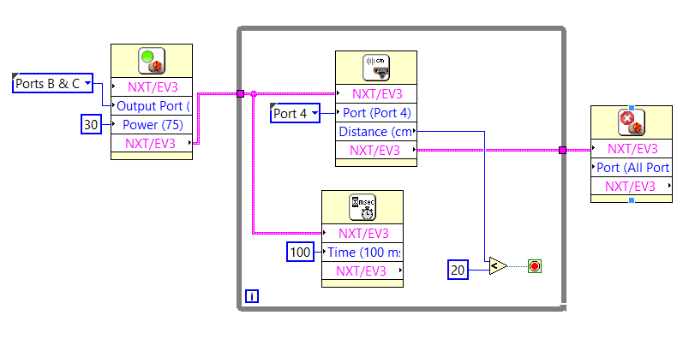
Example 4:
Stop if ultrasonic sensor value < 30 cm

Slide 15
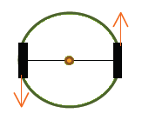
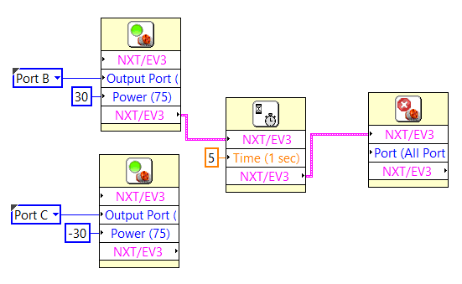
Example 5: Point Turn
Point Turn
Design a LabVIEW program which will perform
«Point Turn» for 5 seconds.

Slide 16
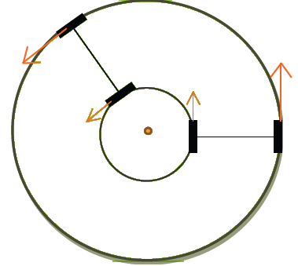
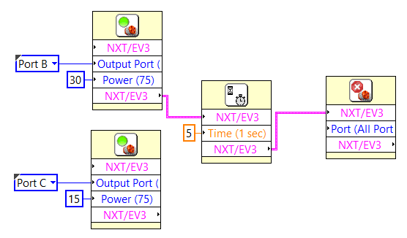
Example 6: Gradual Turn
Gradual Turn
Design a LabVIEW program which will perform
«Gradual Turn» for 5 seconds.

Slide 17
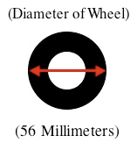
Example 7: Distance control
Design a LabVIEW program which will move robot 10 cm away.
Circumference = Pi x Diameter (56 mm) = 176 mm
Distance / Circumference = Rotations
NXT input requires rotation angle value !!
If Distance = 10 cm, calculate rotation angle
Distance/Circumference = 10 cm / 176 mm = 0,5681 Rotation
Degrees = Rotations x 360
0,5681 * 360 = 204,516 degree

Slide 18
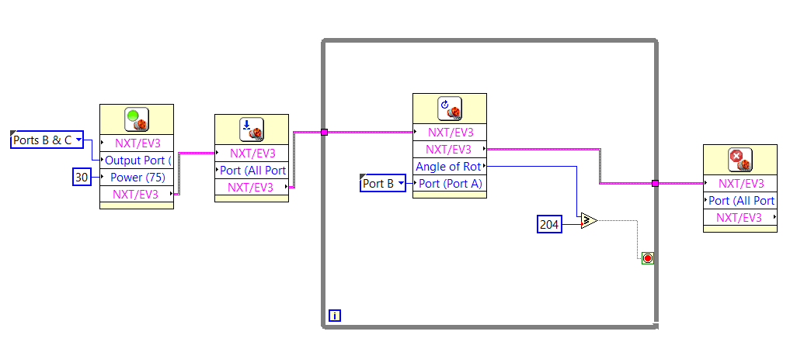
Example 7: Distance control

Slide 19
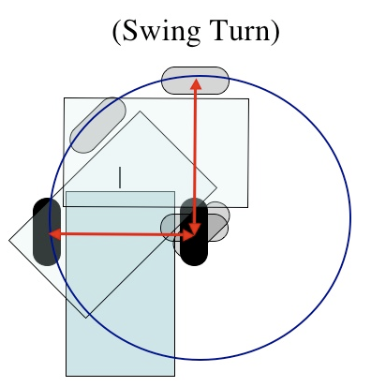
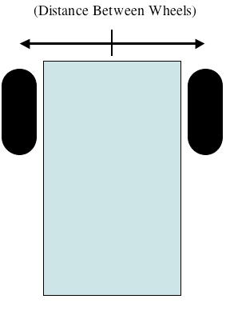
Example 8: 90 degree Swing turn
How can robot perform 90 Degree Swing Turn?
Distance between wheels: 112 mm
First,
1. Calculate distance wheel needs to travel,
(1/4 of circle created by robot swinging around on tire),
Then,
2. Calculate Rotations,
(Rotations = Distance/Circumference)
3. Calculate Degree,
(Degrees = Rotations x 360)

Slide 20
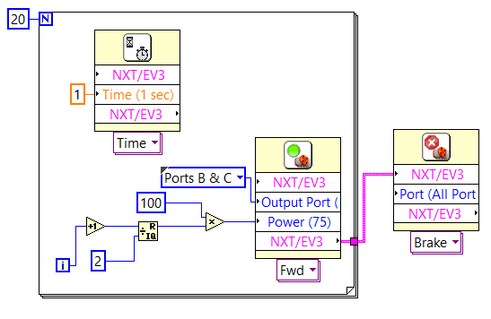
Example 9: Behaviours->Lurch
Algorithm:
1- Turn left and right motor on,
2- Wait 1 second,
3- Turn motors off,
4- Wait 1 second
5- If iteration number is not equal to 10,
go to 1.
6- If iteration number is equal to 10, break.

